Slide 1
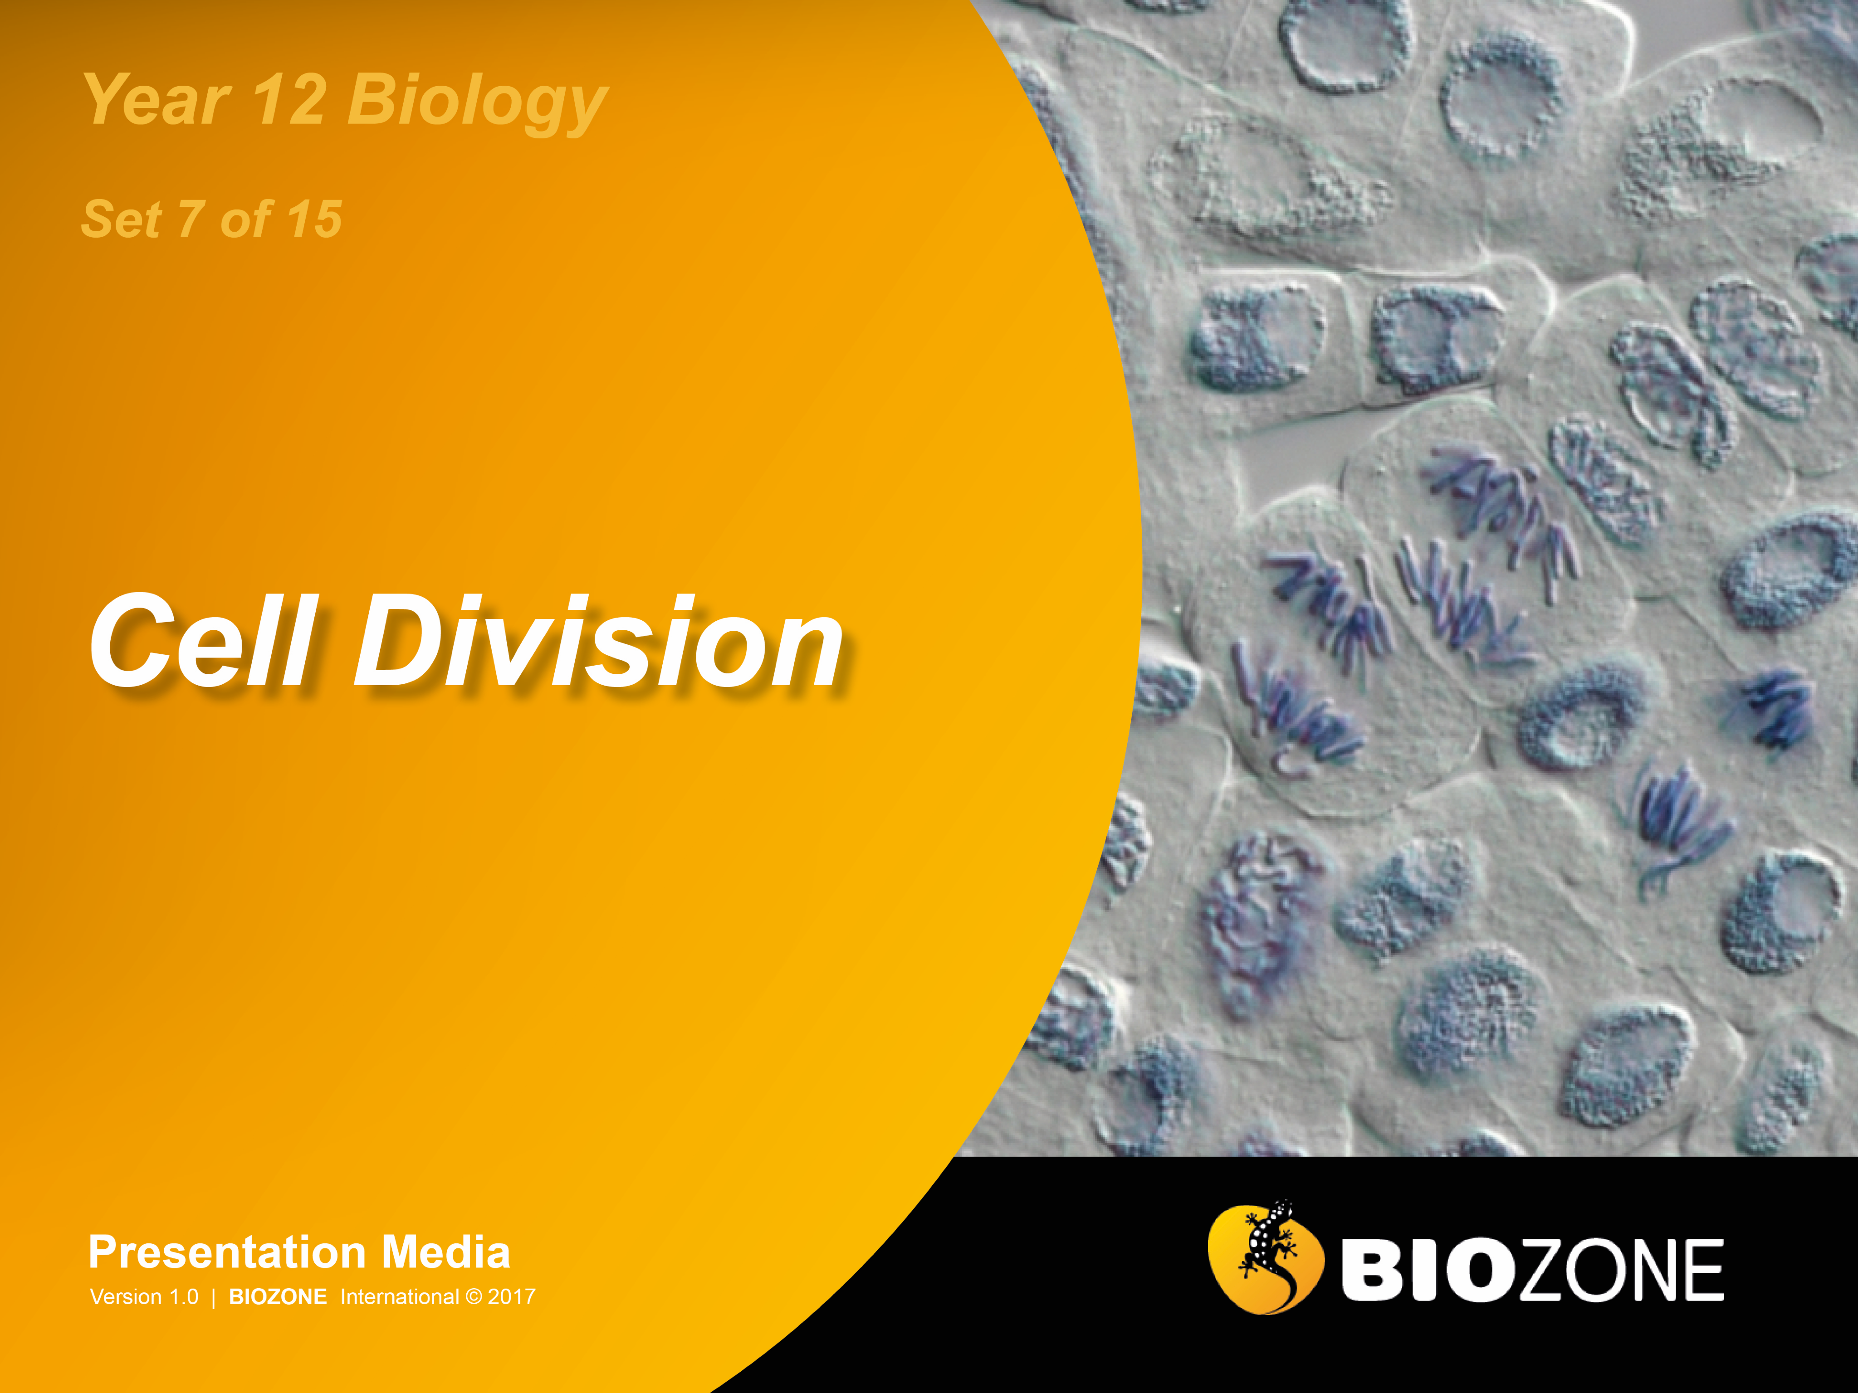

Slide 2
DNA replication
Cell division
Binary fission
Cell division in eukaryotes
Differentiation in human cells
Meiosis
Crossing over

Slide 3
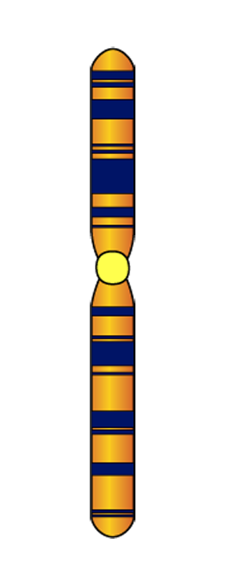
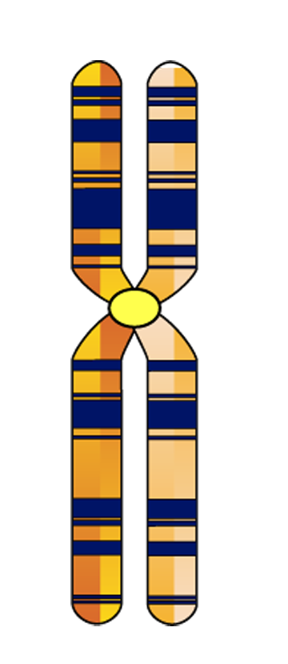
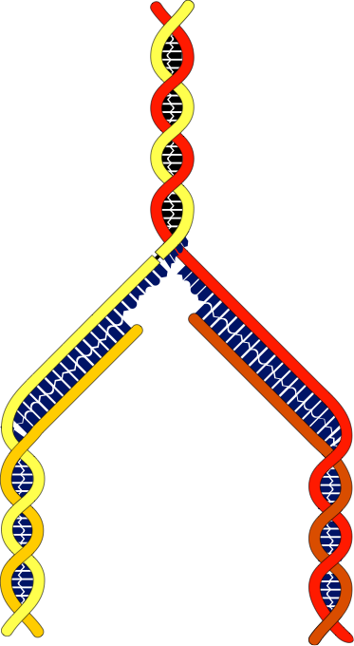

What is DNA Replication?
Parent chromosome
Replicated chromosome
Before a cell can divide, its DNA must be copied (replicated). DNA replication is the process in which DNA is replicated to produce an exact copy of itself.
After the DNA has replicated, each chromosome is made up of two chromatids, which are joined at the centromere. The two chromatids will become separated during cell division to form two separate chromosomes.
DNA replication takes place in the time between cell divisions.
DNA replication is semi-conservative because the replicated DNA consists of one original strand of DNA, and a newly replicated ‘daughter’ strand.
Chromatid
Centromere links sister chromatids
Parent DNA
G
C
A
T
New ‘daughter’ DNA
DNA that will become separate chromatids

Slide 4
DNA Replication
DNA replication consists of three stages:
Helicase unzips DNA and allows to untwist
1. Unwinding.
The DNA strand is unwound to allow replication to occur.
2. Elongation
New DNA strands are made using the original strands as a template.
DNA polymerase
3. Termination
DNA synthesis is completed, and the each new DNA molecule assumes its double helix structure.

Slide 5
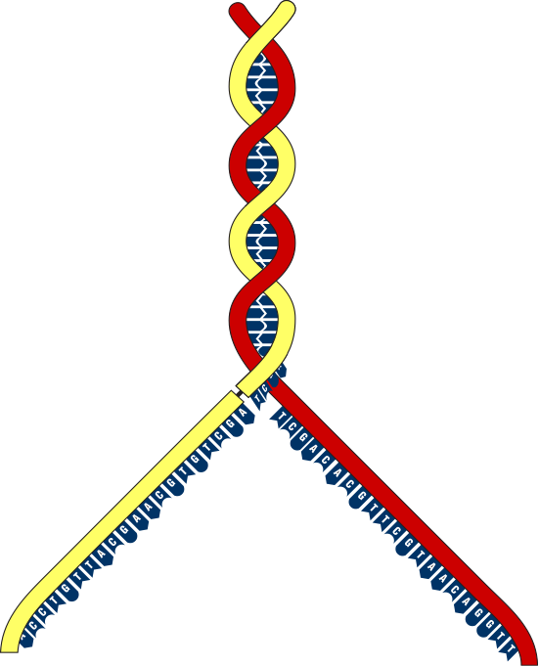
Replication: Unwinding
Single-armed chromosome
as found in non-dividing cell
The coiled DNA is allowed to uncoil by creating a swivel point.
This opens up the DNA molecule for replication.
Enzymes are involved in this initiation phase, unwinding and unzipping the DNA and stabilising the strands so that copying can begin.
Temporary break (swivel point)
Replication fork

Slide 6
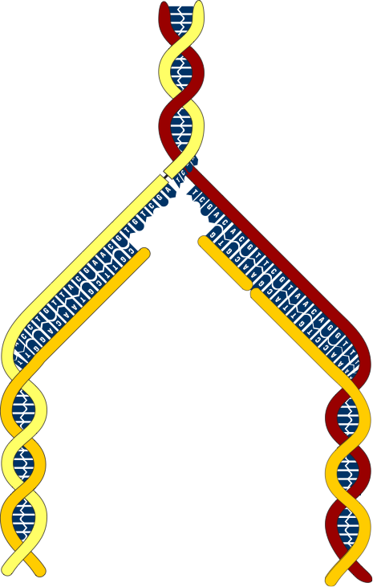
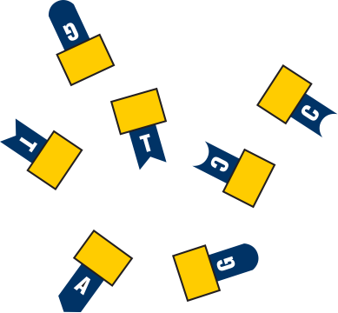

Replication: Elongation
3’
5’
Free nucleotides
are used to construct
the new DNA strand
The unwound DNA strands (parent strands) are used as a template.
New DNA is formed by adding free nucleotides.
The free nucleotides are joined together by the enzyme DNA polymerase.
The new strand is called the daughter strand.
Parent strand of DNA is used as a template.
The new (daughter) strand of DNA.
RNA polymerase synthesises in the 5’ to 3’ direction so one strand is synthesised continuously and one is made in fragments that are later joined.
3’
5’
3’
5’

Slide 7

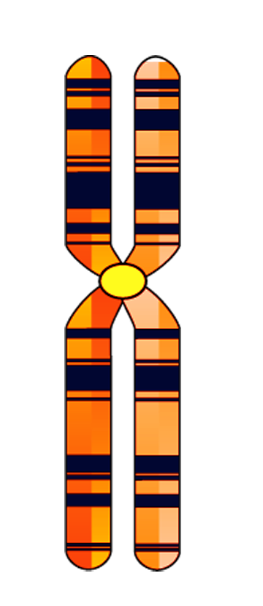
Replication: Termination
3’
5’
When DNA synthesis is completed, the process is said to be terminated.
Each new DNA molecule contains one strand of original DNA, and one strand of newly synthesised DNA.
The two new strands of DNA coils up into a helix as a chromosome.
The newly formed chromosome will later split into two chromatids.
The double strands of DNA coil up into a helix
Chromosome (2 chromatids)
Parent strand
Daughter strand
3’
5’
3’
5’

Slide 8
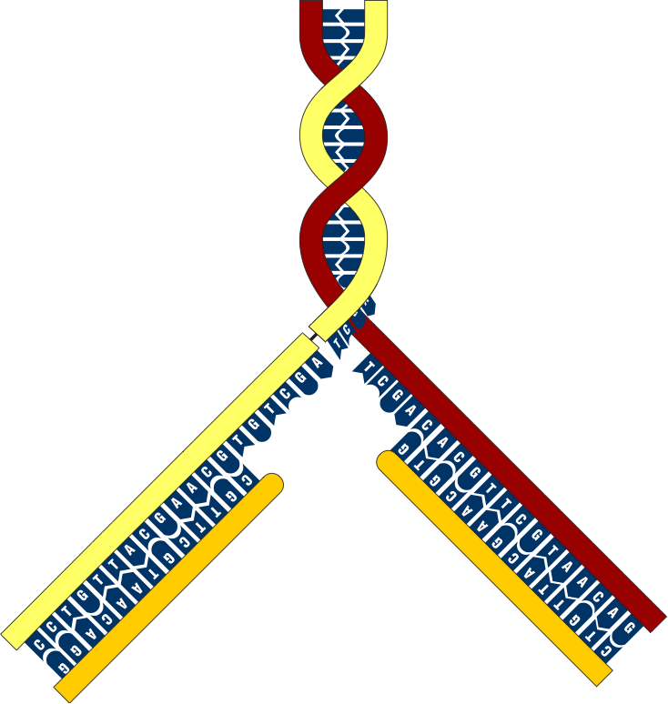

Nucleotide Matching
During DNA replication, new nucleotides (the units that make up the DNA molecule) are added at a region called the replication fork
Free nucleotides are matched with their corresponding template bases following the base pairing rule:
The nucleotides are present as deoxynucleoside triphosphates.
Hydrolysis of these provides the energy for incorporating the nucleotide into the DNA strand.
A | pairs with | T
T | pairs with | A
G | pairs with | C
C | pairs with | G
Parent strand
Parent strand
Two new daughter strands forming

Slide 9
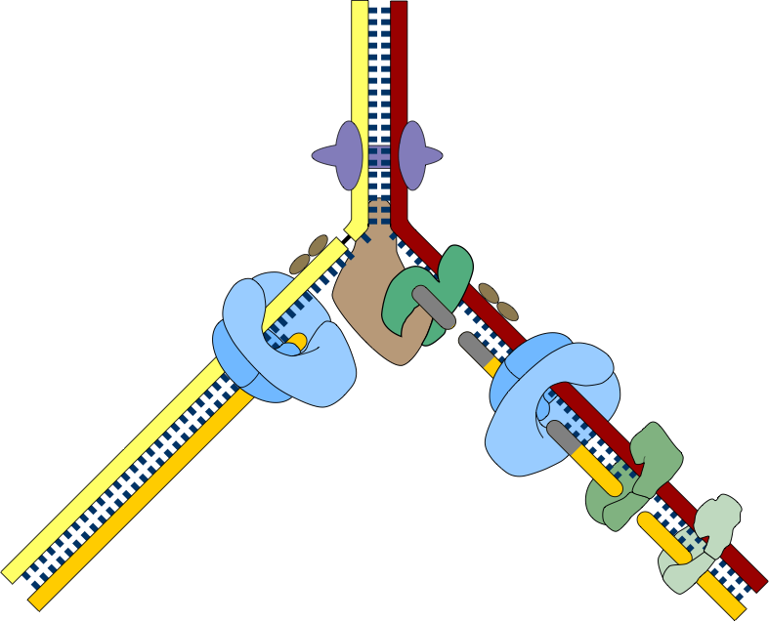
Control of DNA Replication
5'
3'
DNA replication is highly regulated.
Each stage of replication is controlled by enzymes.
Gyrase
Helicase
RNA polymerase
Single-strand binding proteins
DNA polymerase III
DNA polymerase III
DNA polymerase I
DNA ligase
DNA polymerase I
3'
5'
5'
DNA ligase
3'

Slide 10
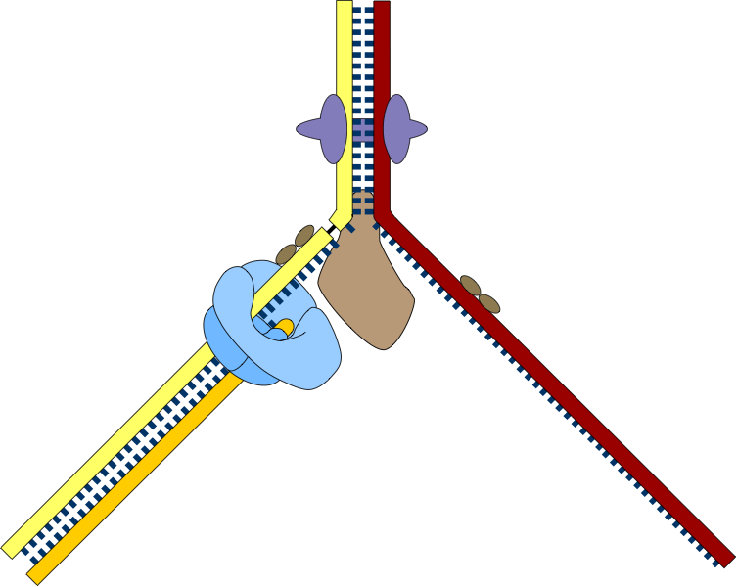
The Leading Strand
5'
3'
Enzymes can build new DNA strands only in the 5’ to 3’ direction.
One strand, the leading strand, is synthesised as a continuous strand.
Gyrase relives tension on the DNA strand.
Overall direction
of replication
Replication fork
Single-strand binding proteins prevent single strands from rewinding and protect them from cleavage.
DNA polymerase III
The parent strand provides a 'template' for synthesis of the new strand
Helicase splits and unwinds the double-stranded DNA
Direction of synthesis
The leading strand is synthesised continuously in the 5' to 3' direction by DNA polymerase III.
3'
5'
5'

Slide 11
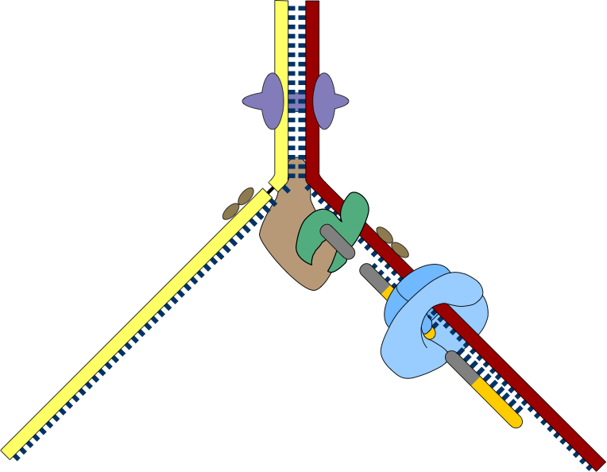
The Lagging Strand
The second new strand, called the lagging strand, is constructed in fragments.
The fragments are later joined together.
5'
3'
RNA polymerase
Makes a short RNA primer which is later removed.
Overall direction
of replication
DNA polymerase III extends the RNA primer with short lengths of complementary DNA to make Okazaki fragments.
Helicase splits and unwinds the double-stranded DNA
RNA primer
Direction of synthesis
New complementary strand is synthesised discontinuously in fragments 1000-2000 bp long
3'
5'

Slide 12
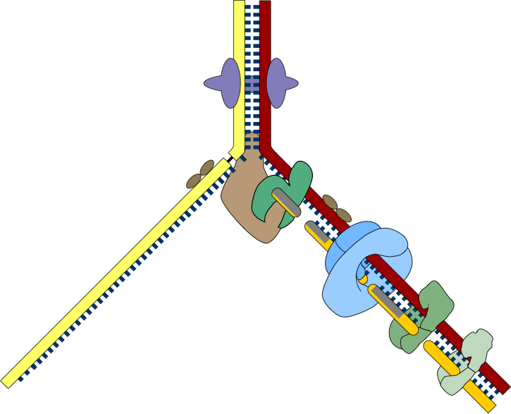
Okazaki Fragments
5'
3'
Overall direction
of replication
DNA polymerase I digests the RNA primer and replaces it with DNA.
DNA ligase joins neighbouring fragments together into longer strands.
The lagging strand is formed in fragments (called Okazaki fragments) which are later joined together.
Direction of
synthesis
3'
5'
3'

Slide 13
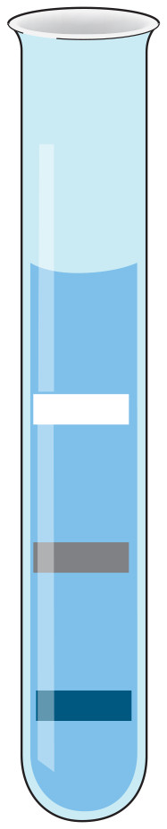
Meselson and Stahl’s
Experiment
Meselson and Stahl determined that DNA replication is semi-conservative.
They grew bacteria in a solution containing heavy nitrogen (15N) until their DNA contained only 15N.
The bacteria were then placed into a growth solution containing normal nitrogen (14N), which is lighter than 15N.
After set generation times the DNA was extracted and centrifuged to separate the light and heavy DNA.
If DNA replicated semi-conservatively, after one generation there would be one type of DNA, an intermediate density DNA band consisting of one strand of heavy 15N and one strand of light 14N DNA.
This is the result that Meselson and Stahl obtained.
Light DNA (14N-14N)
Intermediate DNA (15N-14N)
Heavy DNA (15N-15N)

Slide 14
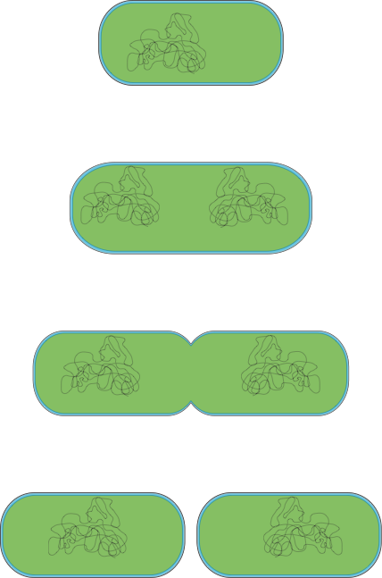
Binary Fission in Prokaryotes
New prokaryotic cells arise through the division of existing ones in a process called binary fission.
Binary fission is a form of asexual reproduction.
Binary fission is not the same as mitosis, which occurs in eukaryotes.
Cell wall
DNA
Plasma membrane
Cell elongation occurs and the chromosome is duplicated.
Cross wall forming
The cell wall and cell membrane begin to grow inwards forming a cross wall.
The ingrowing cell walls meet and two identical cells are formed.

Slide 15
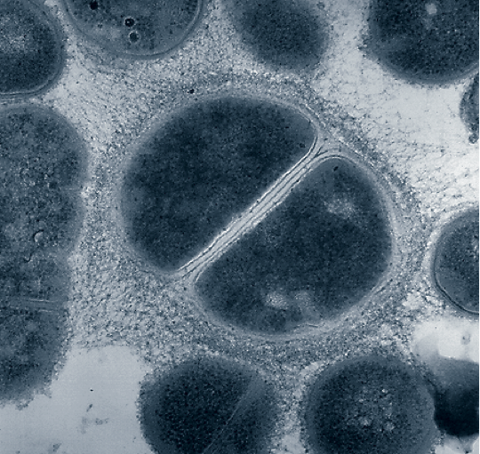
Binary Fission in Prokaryotes
The time required for a bacterial cell to divide, or for the population of bacterial cells to double, is called generation time.
May be quite short (20 minutes) in some species or as long as several days in others.
The gram positive coccus is the process of binary fission. A cross wall (arrow) has formed.
The Salmonella typhimurium bacterium has completed cell division. The separation between the two cells can be clearly seen (arrow).

Slide 16
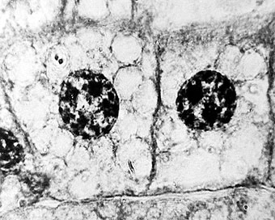
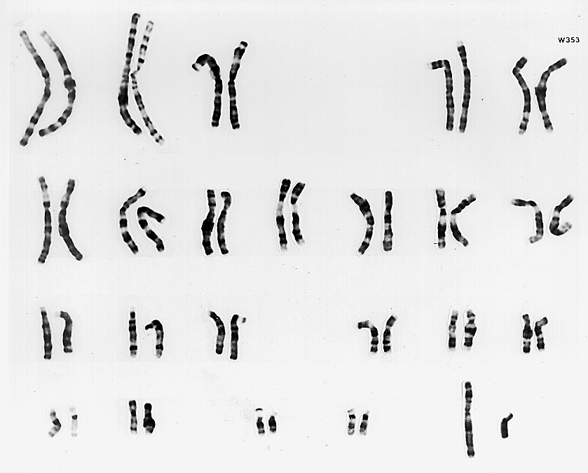
Introduction to Mitosis
Mitosis (nuclear division) and cytokinesis (division of the cytoplasm) together make up M-phase of the cell cycle.
M-phase results in two daughter cells (right).
The cells are genetically identical.
There is no change in chromosomal number.
Cells are diploid, each with two sets of chromosomes.
In humans the diploid number is 46
Mitosis has three main functions:
Growth
Repair
Asexual reproduction (in a small number of eukaryotes).
Normal male karyotype
Humans have 23 pairs of chromosomes, 22 pairs of autosomes and 1 pair of sex chromosomes. The karyotype above is for a normal male. The sex chromosomes (XY in this example) are highlighted.

Slide 17
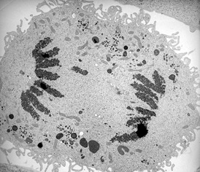
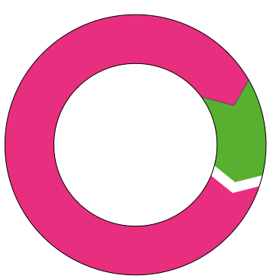
The Cell Cycle in Eukaryotes
Mitosis is just one part of the cell cycle.
There are two main phases in the cell cycle:
Interphase (itself made up of three stages)
M-phase consisting of mitosis (nuclear division) and cytokinesis (division of the cytoplasm)
Interphase
Anaphase: separation of chromosomes.
Photo: EII
Mitosis
Cytokinesis

Slide 18
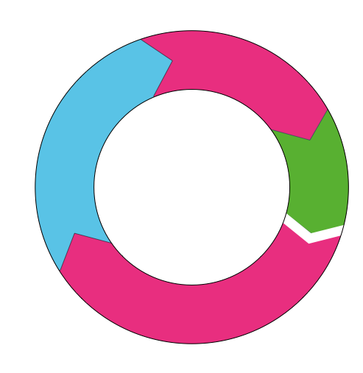
Interphase
G2
Interphase accounts for 90% of the cell cycle.
It is the longest phase of the cell cycle.
Interphase consists of three stages:
First gap phase (G1) The cell increases in size and makes the mRNA and proteins needed for S phase.
Synthesis (S) The cell duplicates its genetic material (chromosomes).
Second gap phase (G2)
The nucleus is well defined
Rapid cell growth and protein synthesis
The cell prepares for mitosis
S
The cell cycle
M
G1
Nucleolus
Centrosome is replicated
Nuclear membrane
Chromatid

Slide 19
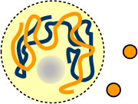
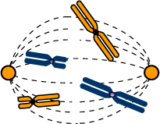
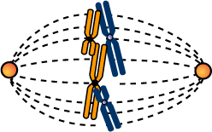

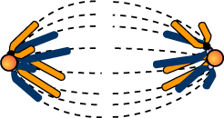
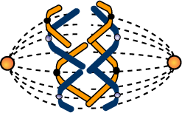
Mitosis and Cytokinesis
Interphase
Early Prophase
Late Prophase
Cell enters mitosis
DNA replicated.
DNA continues condensing.
Chromosomes appear as chromatids.
Metaphase
Centrosome replicated.
Nuclear membrane disintegrates.
Mitotic spindle forms.
Nucleus still well defined.
Nucleolus disintegrates.
Centrosomes move to opposite poles.
Chromosomes line up on the equator of the cell.
Cytokinesis
Telophase
Late Anaphase
Anaphase
Nuclei reform.
Non-kinetochore microtubules elongate the cell.
Chromosomes separate to opposite poles.
Two independent cells.
Cell elongates and furrow develops.

Slide 20
Cell Checkpoints
G2 Checkpoint:
Pass this checkpoint if:
¬ Cell size is large enough.
¬ Replication of chromosomes has been successfully completed.
There are three checkpoints during the cell cycle. A checkpoint is a critical regulatory point in the cell cycle.
At each checkpoint, a set of conditions determines whether or not the cell will continue into the next phase.
For example, cell size is important in regulating whether or not the cell can pass through the G1 checkpoint.
G2
S
The cell cycle
M
G1 checkpoint
Pass this checkpoint if:
¬ Cell size is large enough.
¬ Sufficient nutrients are available.
¬ Signals from other cells have been received.
G1
Metaphase checkpoint
Pass this checkpoint if:
¬ All chromosomes are attached to the mitotic spindle.

Slide 21
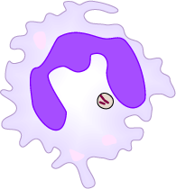
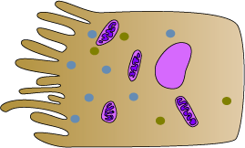
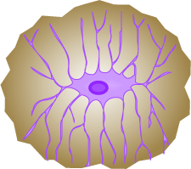
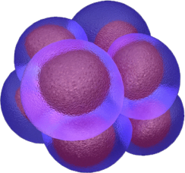
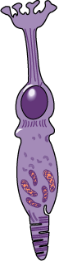
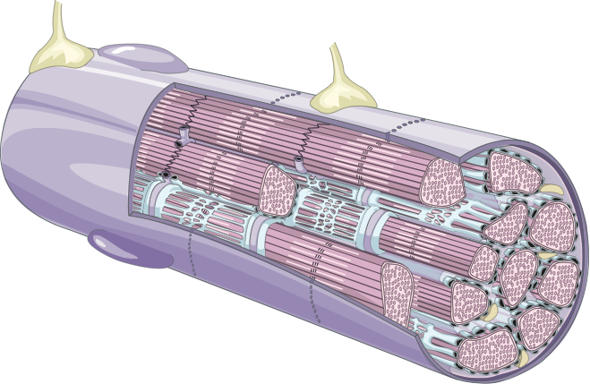

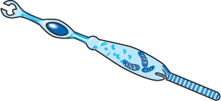
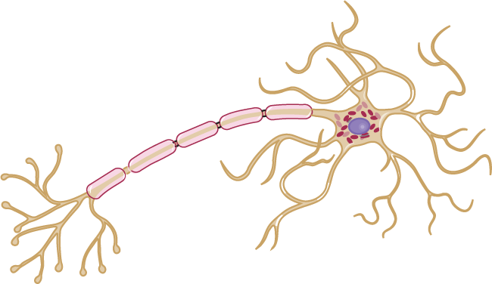
Differentiation of Human Cells
The human body exhibits a high level of cell specialisation.
All of the 230 cell types in a human body are derived from a single zygote by cellular differentiation.
Because the zygote is totipotent, it has the capacity to differentiate into a fully formed embryo.
White blood cell
Intestinal epithelial cell
Bone cell
➙
➙
➙
➙
➙
Muscle fiber
Retinal cone
➙
➙
➙
Red blood cells
Nerve cell
Retinal rod

Slide 22
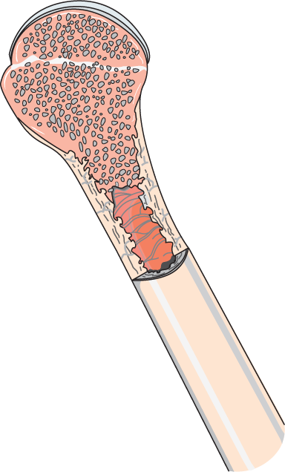
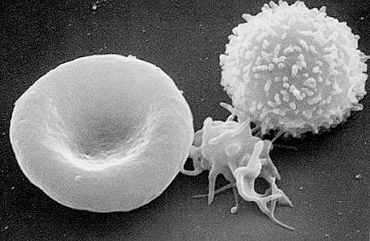
Blood Cell Differentiation
Haematopoiesis describes the production of blood cells.
New blood cells are produced in the red bone marrow.
All types of blood cell develop from a multipotent stem cell or hemocytoblast.
These are capable of mitosis and differentiation into committed precursors of each of the main blood cells.
White blood cell
Inside the long bones of the human body (e.g. femur)
Red bone marrow
Image:NCI Frederick
Red blood cell
Platelet

Slide 23


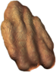



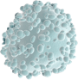

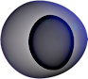
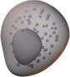


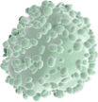

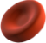
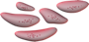
Blood Cell Differentiation
Haematopoiesis from heme (=blood) and poiesis (to make)
Matures in thymus
T lymphocyte
Natural killer (NK) lymphocyte
Lymphoid precursor cell
B lymphocyte
Monocytes and macrophages
Multipotent stem cell
Neutrophil
Basophil
Granulocytes
Eosinophil
Red bone marrow
Myeloid precursor cell
Red blood cells
Megakaryocyte
Platelets

Slide 24
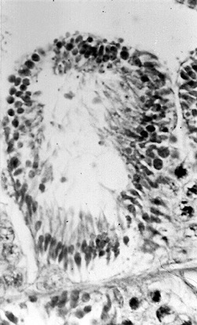
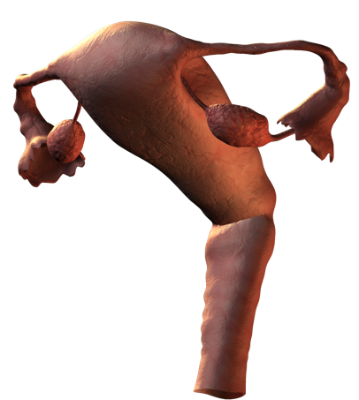
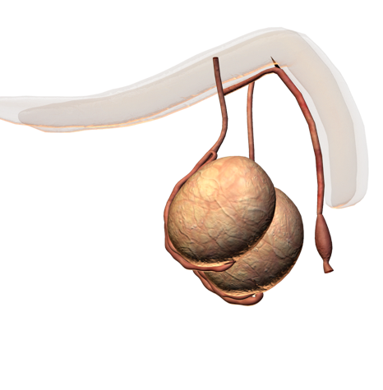
Meiosis In Humans
The purpose of meiosis is to produce haploid sex cells (gametes).
They have one copy of each homologous pair of autosomes plus one sex chromosome.
In humans the haploid number is 23.
A haploid cell results because the chromosomes are replicated once, but the cell undergoes two divisions.
In humans, meiosis only occurs only in the ovaries and testes.
Developing sperm
Testes
Ovaries
Spermatogenesis in the testis

Slide 25
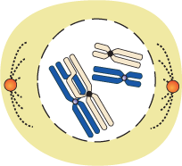
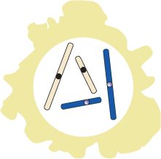
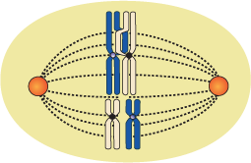
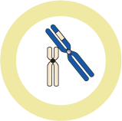








Meiosis
Crossing over may occur at this stage in meiosis
2N
2N
Like mitosis, meiosis is preceded by DNA replication.
Meiosis comprises two divisions:
Meiosis I: This first division separates the homologous chromosomes into two intermediate cells.
Meiosis II: Effectively a mitotic division as sister chromatids are separated into the gametes.
The chromosomal number is halved (1N) during meiosis I, and remains so throughout meiosis II.
First Division
(reduction division)
2N
1N
Intermediate cell
Intermediate cell
Second Division
('mitotic' division)
1N
1N
Gametes (eggs or sperm)

Slide 26





Meiosis I
Interphase
DNA replication
2N
The first division of meiosis is called a ‘reduction’ division because it reduces (halves) the number of chromosomes.
One chromosome from each homologous pair is donated to each intermediate cell.
Prophase 1
Synapsis and crossing over
2N
Metaphase 1
Bivalents line up on the equator
2N
Anaphase 1
Telophase 1
1N
Intermediate cell
Intermediate cell

Slide 27






Meiosis II
NOTE: Half the full chromosome complement shown
1N
The second division of meiosis is called a ‘mitotic’ division, because it is similar to mitosis.
Sister chromatids of each chromosome are pulled apart and are donated to each gamete cell.
Intermediate cell
Prophase 2
1N
Metaphase 2
Anaphase 2
Telophase 2
1N
Gamete (egg or sperm)
Gamete (egg or sperm)

Slide 28



Crossing Over 1
When the replicated chromosomes are paired during the first stage of meiosis, non-sister chromatids may become entangled and segments may be exchanged in a process called crossing over.
Crossing over results in the recombination of alleles (variations of the same gene) producing greater variation in the offspring than would otherwise occur.
Maternal chromosome
Centromere
Chromatids
Chromatids
Paternal chromosome
Genes
Y
X

Slide 29



Crossing Over 2
Chromatids with corresponding gene sequences to become entangled to form chiasma.
‘Equivalent’ segments of homologous chromosomes are able to be exchanged at these points.
The neighbouring chromatids of each of the two homologous chromosomes shown have exchanged genes, leaving the outer chromatids untouched.
Each chromosome will pass into the intermediate cells of meiosis to enter the second division of meiosis.
Chiasma in the process of forming
Chromatid of maternal origin
Crossing over point
Mixed types
Chromatid of paternal origin

Slide 30




Crossing Over 3
During the final division of meiosis, the chromatids that were bound together are separated.
Each of the four chromatids, with any recombined genes, will end up in one of the four gametes.
If some chromatids were not involved in crossing over, some of the gametes will have ‘parental’ allele sequences.
Chromatid of maternal origin
Chromatids of mixed maternal and paternal origin
Chromatid of paternal origin
Each of these four chromosomes will end up in a separate gamete:
Gametes

Slide 31


Slide 32
Conditions of Use
NOTE: Presentation Media = presentations available on CD-ROM/DVD-ROM or as downloads
BIOZONE retains copyright to the intellectual property included in the Presentation Media files, with acknowledgement that certain photos are used under license and are credited appropriately.
You MAY:
Use the Presentation Media files for presentations in your classrooms using a data projector, interactive whiteboard or overhead projector.
Place the Presentation Media files on any staff computer within the school, including staff laptops, but not in contradiction to clause (g).
Place the Presentation Media files on:
The school’s intranet (school computer network)
VLE (Virtual Learning Environment)
A CMS (Content Management System).
Student and staff access must be restricted to those who are enrolled/working on the campus of the registered purchaser. Student and staff access to a VLE or a CMS must be controlled by a user login and password protocol, but not in contradiction to clause (f). If students have access, they need to be made aware of the Conditions of Use and are only allowed to view the content.
Edit and customise the Presentation Media files by adding, deleting, and modifying information to better suit your needs, but not in contradiction to clauses 2 (c) - (d).
Print out the Presentation Media files in PowerPoint® or Keynote® “Handouts” mode for the express purpose of allowing students to make their own notes about the presentation, but not in contradiction to clause (e).
You MAY NOT:
Place the Presentation Media files on to the Internet or on a service that may be accessed off-campus unless access to the service is protected by a user login and password protocol, and is restricted to students and staff enrolled/working on the campus of the registered purchaser.
Place the Presentation Media files on student laptop computers.
REMOVE any of the references to BIOZONE, the title slides, copyright notices, photo credits, or Conditions of Use from the Presentation Media files.
Create a NEW document using any of the graphics/images in the Presentation Media files.
Print the Presentation Media files on to paper to make your own worksheets for distribution to students.
Incorporate any part of the Presentation Media files for the production of another commercial product.
Share or give away any content off-campus. This prohibition apples to, but is not limited to, sharing via the Internet or any website, (examples: YouTube, slide sharing websites).
Conditions of Use are subject to change without notice. Visit http://www.biozone.com.au/faqconditionsofuse/

Slide 33
Photo Credits
Photographic images are used under license from the following commercial photo libraries:
Corel Corporation Professional Photos (uncoded)
ArtToday.com (coded AT)
Clipart.com (coded CA)
PhotoObjects.com (coded PO)
iStock.com (coded iStock)
Hemera Technologies Inc. (coded Hemera)
Photos.com (coded PC)
Education interactive (coded EII)
Digital Stock (coded DS)
LifeArt (coded LA)
Dollar Photo Club (coded DPC)
3D models were created using Poser
Additional artwork and photographs are the property of BIOZONE International Ltd. All rights reserved.
Some 2D artwork has been adapted from TechPool STUDIOS LifeArt Collections, used under licence.
Images from the Public Domain: Where these licenses have been used, authors and licenses have been acknowledged alongside their image.
Centers for Disease Control (coded CDC)
National Institutes of Health (coded NIH)
National Aeronautics and Space Administration (NASA)
Images from the public domain include limited copyright, copyright expired, uncopyrighted, or uncopyrightable material:
Licenses including: GNU Free Documentation License http://www.gnu.org/copyleft/fdl.html
Creative Commons Attribution Share Alike http://creativecommons.org/licenses/by-sa/3.0/
Wikimedia Commons
NOTE: Where images are edited or moved from or within this file, the accompanying photo credit must be retained.

Slide 34


